Slide 1

Student Mentorship and Guidance Management System
CSA 4302 Internet Programming
PROJECT GUIDE
Dr. Kosalairaman
Dheeraj Krushna P(192525230) CSE(AIML)
Srikanth(192411139) CSE
P. Hemanth Reddy(192311086) CSE(cs)

Slide 2
INTRODUCTION
The Student Mentorship and Guidance Management Portal is a centralized platform designed to connect students with mentors.
It helps students receive academic support, career guidance, and personalized learning recommendations.
The portal enables efficient mentor allocation, appointment scheduling, and communication between students and mentors.
It tracks student progress, collects feedback, and improves the overall mentorship and learning experience.

Slide 3
PROBLEM STATEMENT
Lack of Centralized Student Information: Student academic records, performance details, and learning goals are maintained separately, making progress tracking difficult.
Inefficient Mentor Allocation: Assigning suitable mentors to students and managing mentorship appointments can be time-consuming and unorganized.
Limited Guidance and Communication: Students may face difficulties accessing timely academic support, career guidance, and effective communication with mentors.
Inadequate Progress Monitoring: The absence of systematic feedback collection and progress reports makes it difficult to identify student challenges and measure improvement.

Slide 4
OBJECTIVES
Smart Matching: Pair by exact technical skills.
Unified Scheduling: Automate faculty availability blocks.
Progress Tracking: Monitor active milestone completion.

Slide 5
MODULES
Module 1:
Student Profile and Academic Progress Management
Module 2:
Mentor Allocation and Communication Management
Module 3:
Guidance, Feedback and Progress Monitoring

Slide 6
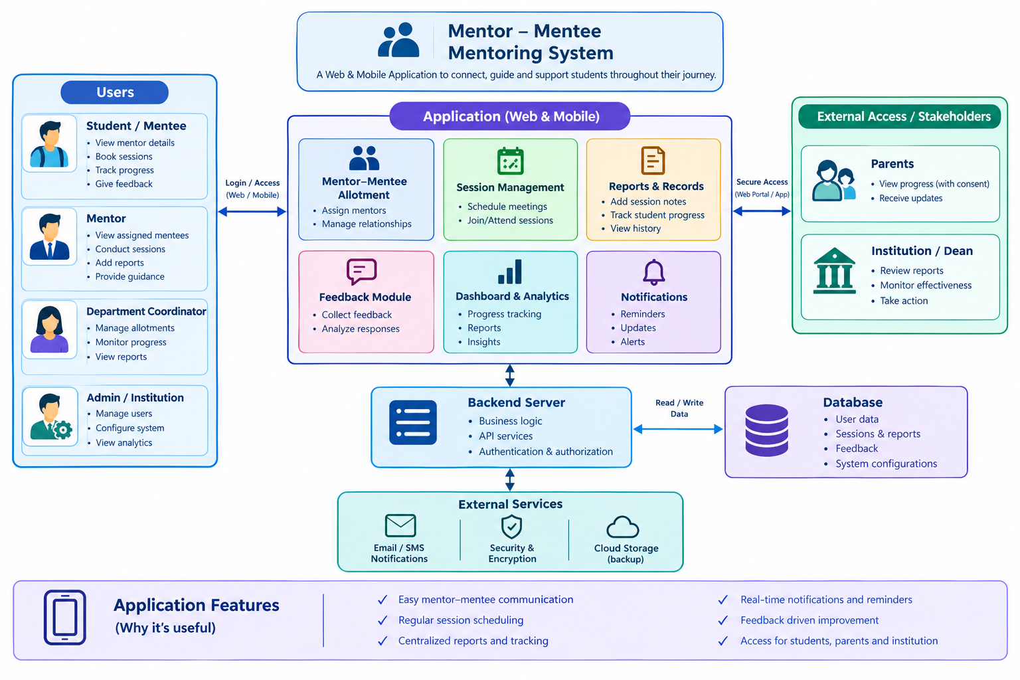
SYSTEM ARCHITECTURE

Slide 7
SYSTEM WORKFLOW
1
2
3
4
5
6
Register and Login
Role-based sign-in for students, mentors, and admin.
Profile Setup
Student adds skills, goals, and academic records.
Mentor Matching
System pairs the student with a mentor by skills and interests.
Session Booking
Student books a slot from the mentor's availability.
Guidance and Feedback
Mentor guides the student; both submit session feedback.
Progress Reports
Milestones are tracked and reports are generated.
Feedback loop: session feedback and progress reports return to mentor allocation, so future matches and guidance keep improving.

Slide 8
TECHNOLOGY STACK
FRONTEND
BACKEND
DATABASE
TOOLS
HTML5
CSS3 and Bootstrap
JavaScript
Responsive layout for web and mobile
Node.js
Express.js
REST APIs
JWT authentication
MySQL
Tables for users, sessions, and feedback
Role-based access control
Hashed passwords
Nodemailer for email alerts
Git and GitHub
VS Code
Postman for API testing
Accessible as a responsive web application on desktop and mobile browsers.

Slide 9
DATABASE DESIGN
STUDENT
ALLOCATION
MENTOR
student_id (PK)
name, department
skills, career_goals
email, password_hash
allocation_id (PK)
student_id (FK)
mentor_id (FK)
status
mentor_id (PK)
name, department
expertise
availability_slots
1 : N
N : 1
1 : N
1 : N
PROGRESS
SESSION
FEEDBACK
progress_id (PK)
student_id (FK)
milestone
status
session_id (PK)
allocation_id (FK)
date_time
notes
feedback_id (PK)
session_id (FK)
rating
comments
1 : N
PK = primary key, FK = foreign key

Slide 10
MODULE 1
Student Profile and Academic Progress Management
Student Profile: Students register and maintain details such as department, skills, interests, and career goals.
Academic Records: Marks, attendance, and semester-wise performance are stored together in one central place.
Progress Dashboard: Performance trends and milestone completion are shown through simple charts and summaries.
Role-Based Access: Student data is visible only to the student, the assigned mentor, and the administrator.

Slide 11
MODULE 2
Mentor Allocation and Communication Management
Smart Mentor Matching: Mentors are allocated by matching student skills, interests, and goals with mentor expertise.
Appointment Scheduling: Faculty publish availability slots; students book and reschedule sessions without clashes.
Communication: Messaging and notifications handle queries, meeting requests, and session reminders.
Allocation Management: Administrators review, reassign, and balance mentor workload.

Slide 12
MODULE 3
Guidance, Feedback and Progress Monitoring
Guidance: Mentors share personalized academic advice, career guidance, and learning recommendations.
Feedback Collection: Students and mentors submit feedback after each session to improve mentorship quality.
Progress Monitoring: Milestone completion is tracked so students who need extra support are identified early.
Progress Reports: Reports summarize improvement for students, mentors, and the institution.

Slide 13
IMPLEMENTATION PROGRESS
Add screenshot here
Add screenshot here
Add screenshot here
Module 1: Student Profile
Profile details, academic records, and progress dashboard
Module 2: Mentor Allocation
Mentor matching, availability, and session booking
Module 3: Feedback and Reports
Feedback form, progress monitoring, and reports

Slide 14
WORK PLAN
ZEROTH REVIEW
Completed
FIRST REVIEW
In progress
SECOND REVIEW
Upcoming
FINAL REVIEW
Upcoming
Problem statement
Objectives and modules
Literature survey
System architecture
Design of all three modules
Workflow and database design
Technology stack finalized
Initial implementation
Complete module development
Integrate the three modules
Testing and bug fixing
Deployment
Performance evaluation
Final report and demonstration

Slide 15
LITERATURE SURVEY
S. No | Research Paper | Year | Limitations
1 | Guided Student Profile System: Mentor Feedback Integration | 2024 | Limited personalized guidance and progress tracking.
2 | A Mentorship-Driven Decision Support Platform for Career Planning in Undergraduate Engineering Education | 2026 | Focuses mainly on career planning.
3 | Bridging the Gap: Developing an Alumni Association Platform to Enhance Student Guidance and Institutional Connectivity | 2025 | Limited focus on continuous academic mentoring.
4 | Enhancing Career Development: An AI-Driven Mentorship Platform for Student-Mentor Connections | 2025 | Primarily focuses on AI-based mentor connections.

Slide 16
REFERENCE
Sadasivam, V. R., Sanjaykumar, V., Imam, A. S., & Vasanthan, R. (2024). Guided Student Profile System: Mentor Feedback Integration. 2024 International Conference on Intelligent Systems for Cybersecurity (ISCS), IEEE, 1–5.
Dhumal, A. D. (2026). A Mentorship-Driven Decision Support Platform for Career Planning in Undergraduate Engineering Education.
Jaiswal, A., Solanki, P., Rathore, R., Pillai, S., Jain, S., Berchha, T., & Toke, V. (2025). Bridging the Gap: Developing an Alumni Association Platform to Enhance Student Guidance and Institutional Connectivity. International Journal of Knowledge Based Computer Systems, 13(1), 38.
Charanya, P., Nidhish, M., Prajesh, U. R., Saktheeswar, K., & Sanjana, S. P. (2025). Enhancing Career Development: An AI-Driven Mentorship Platform for Student-Mentor Connections. 2025 International Conference on Computational, Communication and Information Technology (ICCCIT), IEEE, 147–152.

Slide 17
THANK YOU!

